Slide 1
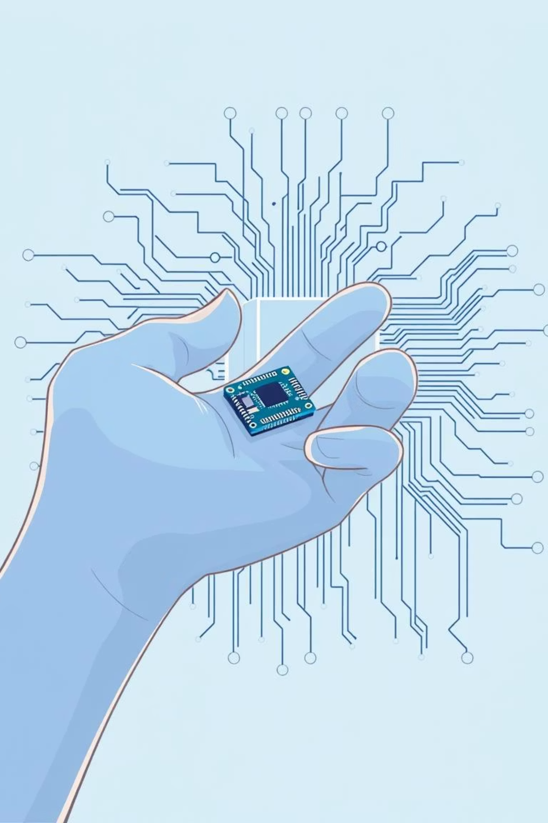
TinyML for Indoor Localization
CSE499A Proposal report Group N0. 6 1. Mueid Islam Arian- 2121947 2. Mahamudul Hasan - 2121379642 3. Nafiz un nabi Ishan- 212326042

Slide 2




Foundation: TinyML and Indoor Localization
What is TinyML?
Indoor Localization
Why It Matters
Running deep learning models directly on resource-constrained microcontrollers (MCUs) to perform on-device inference.
Determining the precise position of people or assets inside buildings, crucial when GPS signals are unavailable.
Essential for real-world applications: patient monitoring in healthcare, asset tracking, and safety protocols in IoT systems.
Our focus is on developing robust and cost-effective solutions tailored for the socio-economic context of Bangladesh.

Slide 3
Addressing the Local Context: Challenges in Bangladesh
Low-power IoT deployments face specific hurdles in developing economies. We must design for resilience and affordability.
Infrastructure Limitations
Cloud Dependency Cost
The Demand for On-Device Tech
Limited access to high-end IoT infrastructure and stable power/network coverage in rural and semi-urban areas.
High operational costs associated with continuous connectivity and reliance on expensive, high-bandwidth cloud-based ML solutions.
A critical need for low-power, low-cost, and high-reliability solutions that perform machine learning locally on the device.

Slide 4




Project Objectives: Solution Architecture
Our mission is to deliver optimized, deployable models for specific regional needs.
Model Design
TinyML Optimization
Build a lightweight indoor localization model using innovative network architectures.
Employ model compression techniques like Quantization and Knowledge Distillation.
Hardware Targeting
Local Deployment
Ensure models are optimized for ultra-low resource hardware (e.g., MCUs with 32–64 KB RAM).
Design use-cases specifically suited for high-impact areas in Bangladesh (hospitals, schools, disaster relief).

Slide 5

TinyML Concepts and Constraints
TinyML's Role: Crucial for enabling intelligent, real-time edge processing without constant network access—ideal for low-resource environments.
Localization Methods: Utilizing existing low-cost infrastructure signals (RSSI, Bluetooth Low Energy (BLE), Wi-Fi) rather than expensive proprietary systems.
MCU Limitations: Strict power, memory (RAM/Flash), and processing constraints dictate the maximum size and complexity of the deployable model.
Integration: These concepts align to provide an offline, battery-friendly, and cost-effective localization solution.

Slide 6



Proposed Approach: Advanced Architectures and Compression
We tackle the challenge of high-accuracy, low-size modeling using modern network architectures and aggressive compression.
Core Models
Model Compression
Deployment Goal
Exploring Transformer (MDCSA) and Mamba architectures, focusing on Mamba's efficiency for TinyML applications.
Applying Quantization (FP32 to INT8) to drastically reduce memory footprint and Knowledge Distillation (Teacher-Student) for size reduction.
Successfully deploying the final optimized model onto devices with only 32KB to 64KB of available RAM.

Slide 7

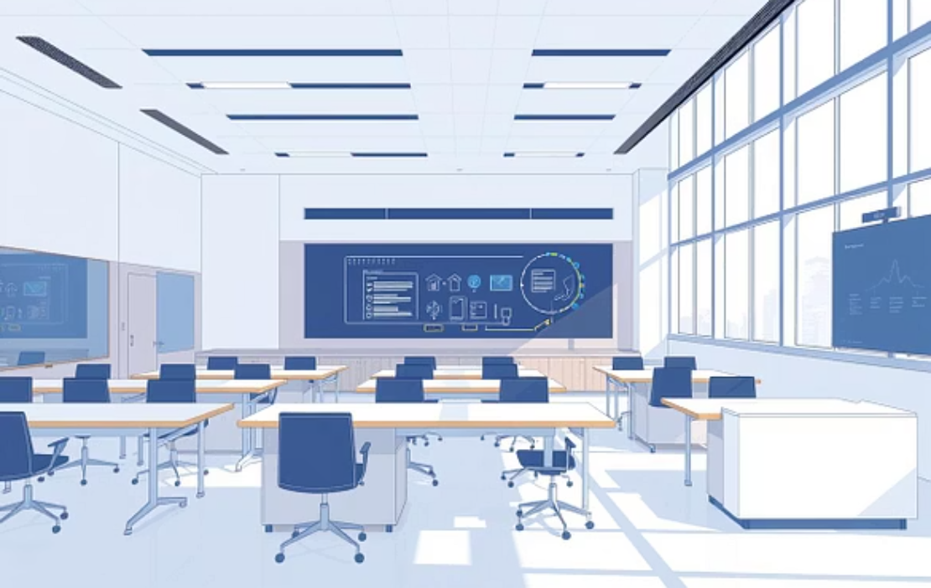

Data Collection and Preprocessing
Robust datasets simulating typical building environments are key to model success.
Dataset Source: In-home/building data collected using existing BLE and Wi-Fi RSSI signals to reflect real-world variability.
Target Scenarios: Focusing data collection on relevant Bangladeshi environments: government hospitals, university complexes, and multi-story offices/shelters.
Preparation: Thorough preprocessing includes handling missing signal data, normalization, and accurate ground-truth labeling for training the localization model.

Slide 8



Architectural Comparison and Deployment
Evaluating models based on accuracy, size, and suitability for low-power MCUs.
Transformer (MDCSA)
Mamba Architecture
Final Deployment
Offers strong localization accuracy but typically results in a large model size, necessitating aggressive compression.
A natively lighter model, providing a better baseline architecture for immediate deployment within TinyML constraints.
Targeting deployment on resource-constrained MCUs like STM32 or CC2650, which are commonly available and energy-efficient.

Slide 9
Experimental Setup and Evaluation Metrics
We ensure rigorous evaluation by measuring both performance and deployability.
Training & Validation
Standard data split applied to assess model generalization across different building environments.
Compression Steps
Systematic application of quantization and distillation techniques, measuring reduction at each step.
Key Metrics
Evaluation based on Accuracy, F1-score (for localization), and crucial factors like Model Size (in KB).
Hardware Simulation
Considering real-world hardware constraints: power consumption and latency limits on the target MCUs.

Slide 10
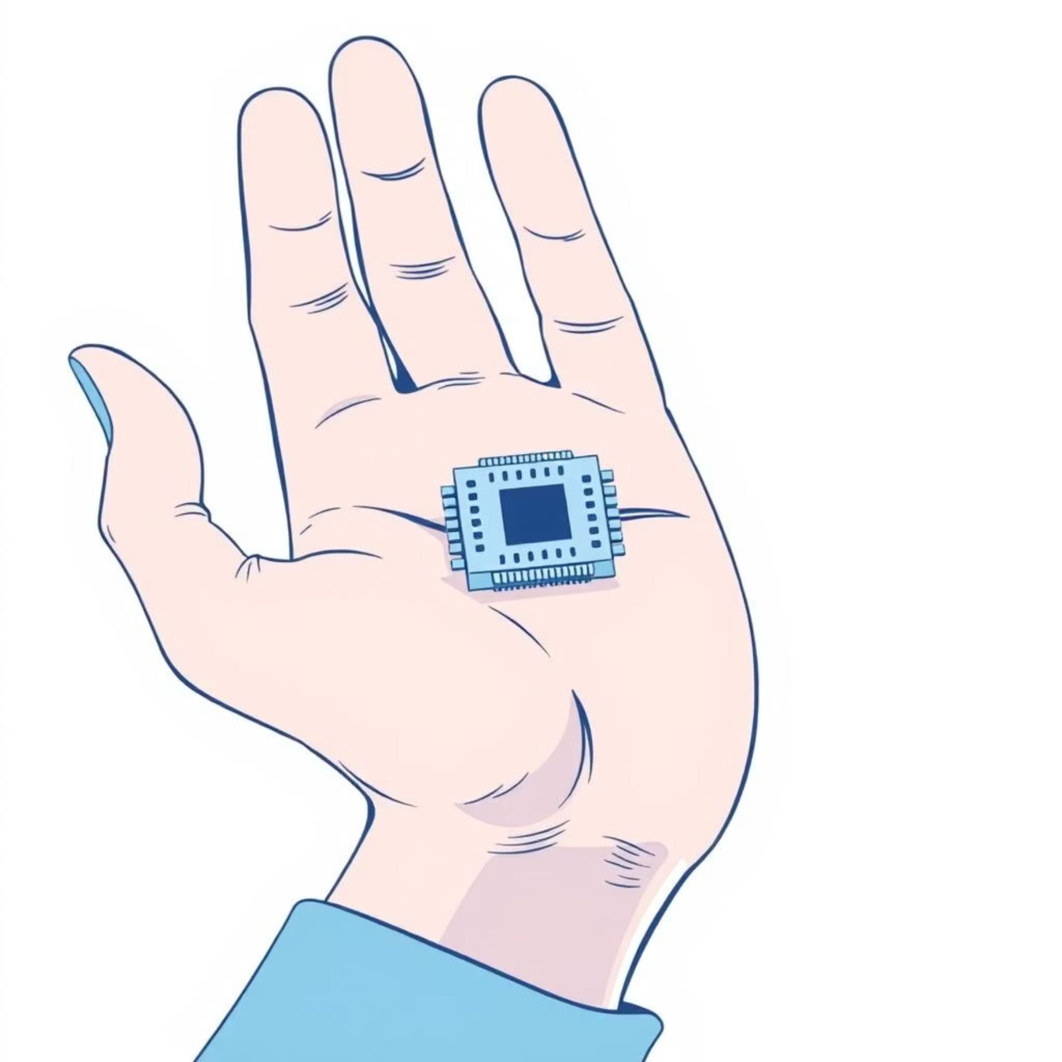
Results and Impact Analysis
Comparative results highlight the necessary trade-offs for successful TinyML integration.
Quantized Transformer
Significant memory reduction, moderate accuracy drop.
Suitability for Bangladesh
Low Cost: Utilizes affordable, widely available hardware.
Mamba vs. Baseline
Superior size-to-accuracy ratio for resource limits.
Offline Capability: On-device inference eliminates dependence on continuous internet connection.
Efficiency: Low power consumption extends battery life in remote settings.
Memory & Latency
Demonstrable improvement, leading to lower power usage.
Trade-offs: Successful deployment hinges on finding the optimal balance between localization accuracy and ultra-low model size (KB).

